Slide 1



Node.Js
with
VScode
© Copyrights 2021. Wedatalab All Rights Reserved.

Slide 2
게시판 구조
Registration
Join function
Login
New Memo Page
Write function
Board
Board
Search function
Delete function
Logout function
Welcome Page
New Memo Page
Welcome Page
Login
Board
Login
Login function
Registration
Welcome Page(back)
Update Memo Page
Update function
Board
© Copyrights 2021. Wedatalab All Rights Reserved.

Slide 3
게시판 구조
Registration
Join function
Login
New Memo Page
Write function
Board
Board
Search function
Delete function
Logout function
Welcome Page
New Memo Page
Welcome Page
Login
Board
Login
Login function
Registration
Welcome Page(back)
Update Memo Page
Update function
Board
© Copyrights 2021. Wedatalab All Rights Reserved.

Slide 4
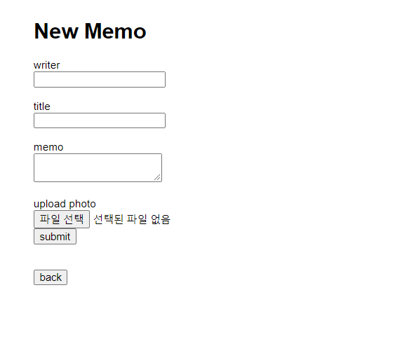
게시글 작성 쿼리문
© Copyrights 2021. Wedatalab All Rights Reserved.

Slide 5
게시글 작성 쿼리문
InsertMemo
INSERT INTO MEMOS (WRITER, TITLE, CONTENT, IMAGE, CREATED_AT, UPDATED_AT) VALUES (＇김규리＇,＇게시글 title입니다.＇,＇게시글 내용입니다', ＇이미지 경로입니다', NOW(),NOW())
INSERT INTO MEMOS (WRITER, TITLE, CONTENT, IMAGE, CREATED_AT, UPDATED_AT) VALUES ('${writer}','${title}','${content}', '${image_path}', NOW(),NOW())
© Copyrights 2021. Wedatalab All Rights Reserved.

Slide 6
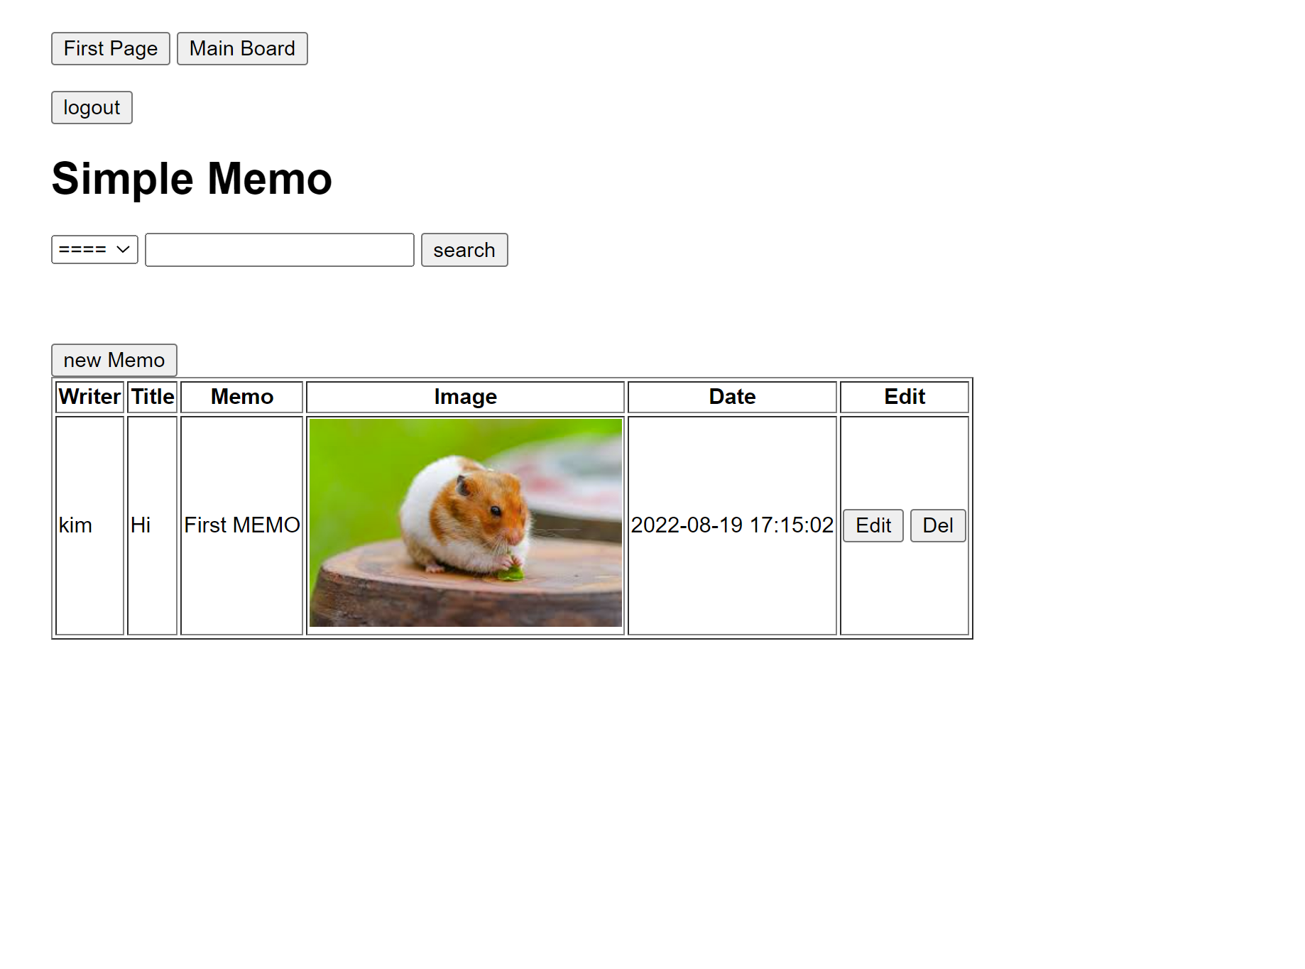
게시글 전체 조회 쿼리문
© Copyrights 2021. Wedatalab All Rights Reserved.

Slide 7
게시글 전체 조회 쿼리문
getAllMemos
SELECT * FROM MEMOS ORDER BY ID DESC
© Copyrights 2021. Wedatalab All Rights Reserved.

Slide 8
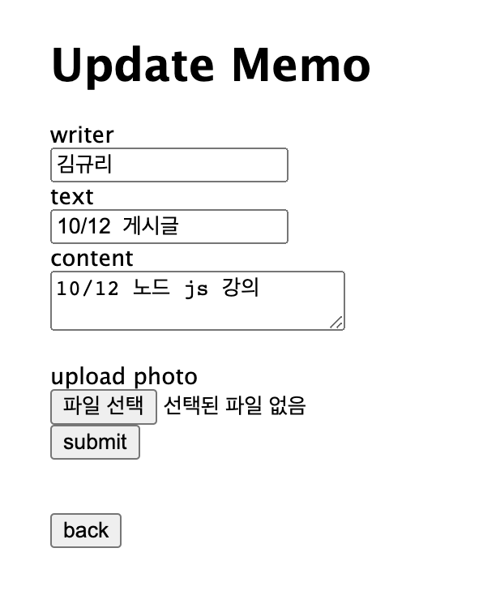
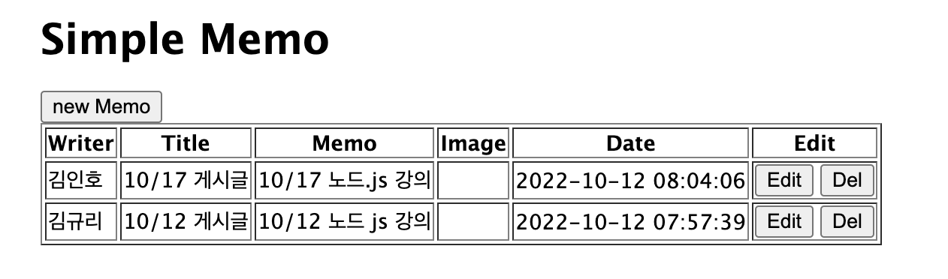
특정 게시글 조회 by ID 쿼리문
© Copyrights 2021. Wedatalab All Rights Reserved.

Slide 9
특정 게시글 조회 by ID 쿼리문
getMemoById
SELECT * FROM MEMOS WHERE ID =2
© Copyrights 2021. Wedatalab All Rights Reserved.

Slide 10
특정 게시글 조회 by ID 쿼리문
getMemoById
SELECT * FROM MEMOS WHERE ID =2
SELECT * FROM MEMOS WHERE ID =${id}
© Copyrights 2021. Wedatalab All Rights Reserved.

Slide 11
특정 게시글 조회 by ID 쿼리문
getMemoById
SELECT * FROM MEMOS WHERE ID =2
SELECT WRITER, TEXT, CONTENT,IMAGE_PATH FROM MEMOS WHERE ID =${id}
© Copyrights 2021. Wedatalab All Rights Reserved.

Slide 12
특정 게시글 수정 쿼리문
updateMemoById
UPDATE MEMOS SET WRITER =‘김규리', TITLE=‘10/30일 게시글', CONTENT=‘10/30 노드 js 강의', IMAGE ='', UPDATED_AT=NOW() WHERE ID=2;
© Copyrights 2021. Wedatalab All Rights Reserved.

Slide 13
특정 게시글 수정 쿼리문
updateMemoById
UPDATE MEMOS SET WRITER =‘김규리', TITLE=‘10/30일 게시글', CONTENT=‘10/30 노드 js 강의', IMAGE ='', UPDATED_AT=NOW() WHERE ID=2;
UPDATE MEMOS SET WRITER ='${writer}', TITLE='${title}', CONTENT='${content}', IMAGE ='${image_path}', UPDATED_AT=NOW() WHERE ID=${id}
© Copyrights 2021. Wedatalab All Rights Reserved.

Slide 14
특정 게시글 삭제 쿼리문
delete from table이름
© Copyrights 2021. Wedatalab All Rights Reserved.

Slide 15
특정 게시글 삭제 쿼리문
DELETE FROM MEMOS WHERE ID=1
DELETE FROM MEMOS WHERE ID=${id}
© Copyrights 2021. Wedatalab All Rights Reserved.

Slide 16
Express 프로젝트
새 메모 페이지 만들기 (index.js(GET), newMemo.ejs)
업데이트 메모 만들기 (index.js(GET), db.js, updateMemo.jes)
새 메모 기능 (index.js(POST), db.js)
메모 수정 기능 (index.js(POST), db.js)
메모 삭제 기능 (index.js(POST), db.js)
© Copyrights 2021. Wedatalab All Rights Reserved.

